Slide 1


Alexander Lvovsky
THREE WAYS TO SKIN A CAT
CHARACTERIZE A QUANTUM OPTICAL “BLACK BOX”

Slide 2
Outline
Introduction: coherent-state quantum process tomography
Method 1: approximating the P function
Method 2: integration by parts
Method 3: maximum-likelihood reconstruction

Slide 3
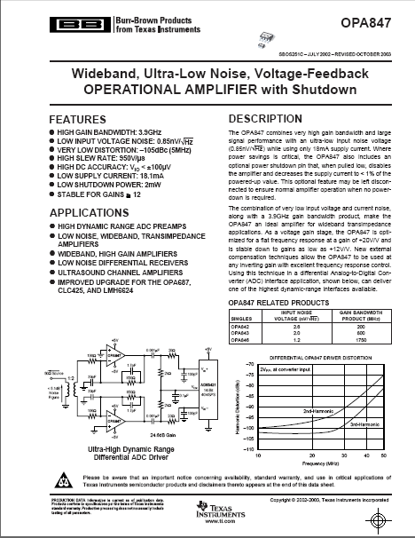
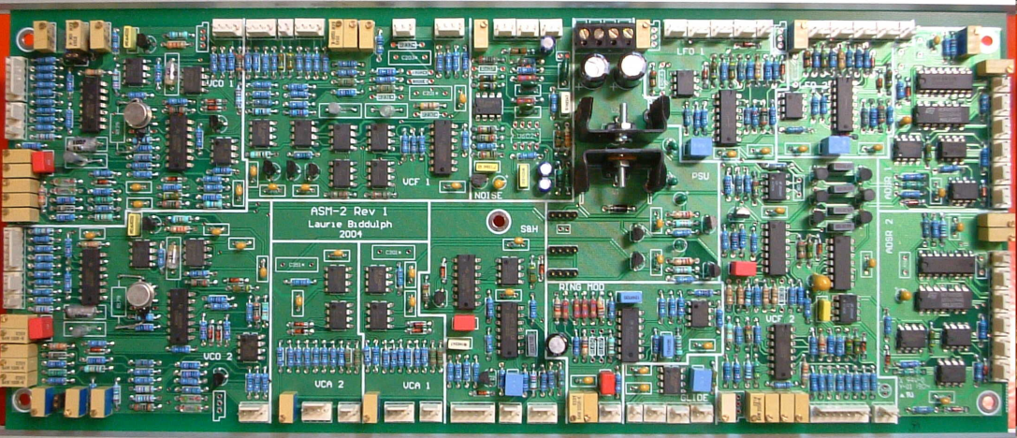
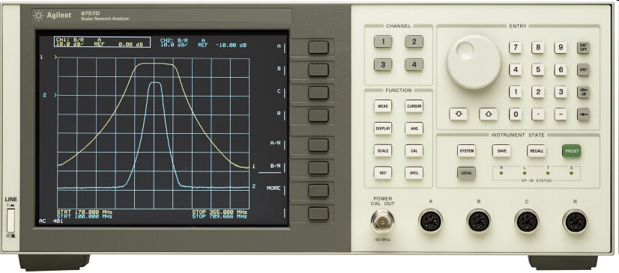
Why we need
process tomography
In classical electronics
Constructing any complex circuit requires
precise knowledge of each component’s operation
This knowledge is acquired by means of network analyzers
  Measure the component’s response to simple
  sinusoidal signals
  Can calculate the component’s response
  to arbitrary signals

Slide 4
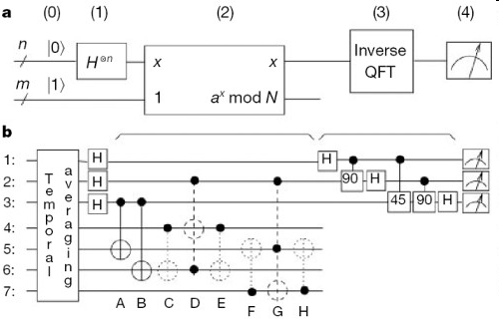
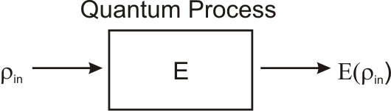
Why we need
process tomography
In quantum information processing
  If we want to construct a complex
  quantum circuit, we need the same
  knowledge
Quantum process tomography
  Send certain “probe” quantum states
  into the quantum “black box”
  and measure the output
  Can calculate what the “black box”
  will do to any other quantum state

Slide 5
Quantum processes
General properties
  Positive mapping
  Trace preserving or decreasing
  Not always linear in the quantum Hilbert space
    Example: decoherence
    |1⟩ → |1⟩
    |2⟩ → |2⟩
    but |1⟩ + |2⟩ → |1⟩⟨1| + |2⟩⟨2|
  Always linear in density matrix space

Slide 6
Quantum process tomography
Methodology
The approach
  A set of “probe” states {ρ_{i}} must form a spanning set in the space of density matrices
  Subject each ρ_{i} to the process, measure E(ρ_{i})
  Any arbitrary state ρ can be decomposed:
  Linearity →
  → Process output for an arbitrary state can be determined
Challenges
  Numbers to be determined = (Dimension of the Hilbert space)⁴
    Process on a single qubit → 16
    Process on two qubits → 256
  Need to prepare multiple, complex quantum states of light
  → All work so far restricted to discrete Hilbert spaces of very low dimension

Slide 7
The main idea
M. Lobino, D. Korystov, C. Kupchak, E. Figueroa, B. C. Sanders and A. L., Science 322, 563 (2008)
Decomposition into coherent states
  Coherent states form a “basis” in the space of optical density matrices
  Glauber-Sudarshan P-representation (Nobel Physics Prize 2005)
Application to process tomography
  Suppose we know the effect of the process E(|α⟩⟨α|) on each coherent state
  Then we can predict the effect on any other state
The good news
  Coherent states are readily available from a laser.
  No nonclassical light needed
  Complete tomography

Slide 8
The process tensor
Fock basis representation of the process
  Since
  it is enough to know for all relevant photon numbers m, n,
  because then
The process tensor
  contains full information about the process
Expressing the process tensor using the P function
In practice: reconstructed up to some n_{max}

Slide 9
Method 1
Approximating the P function

Slide 10
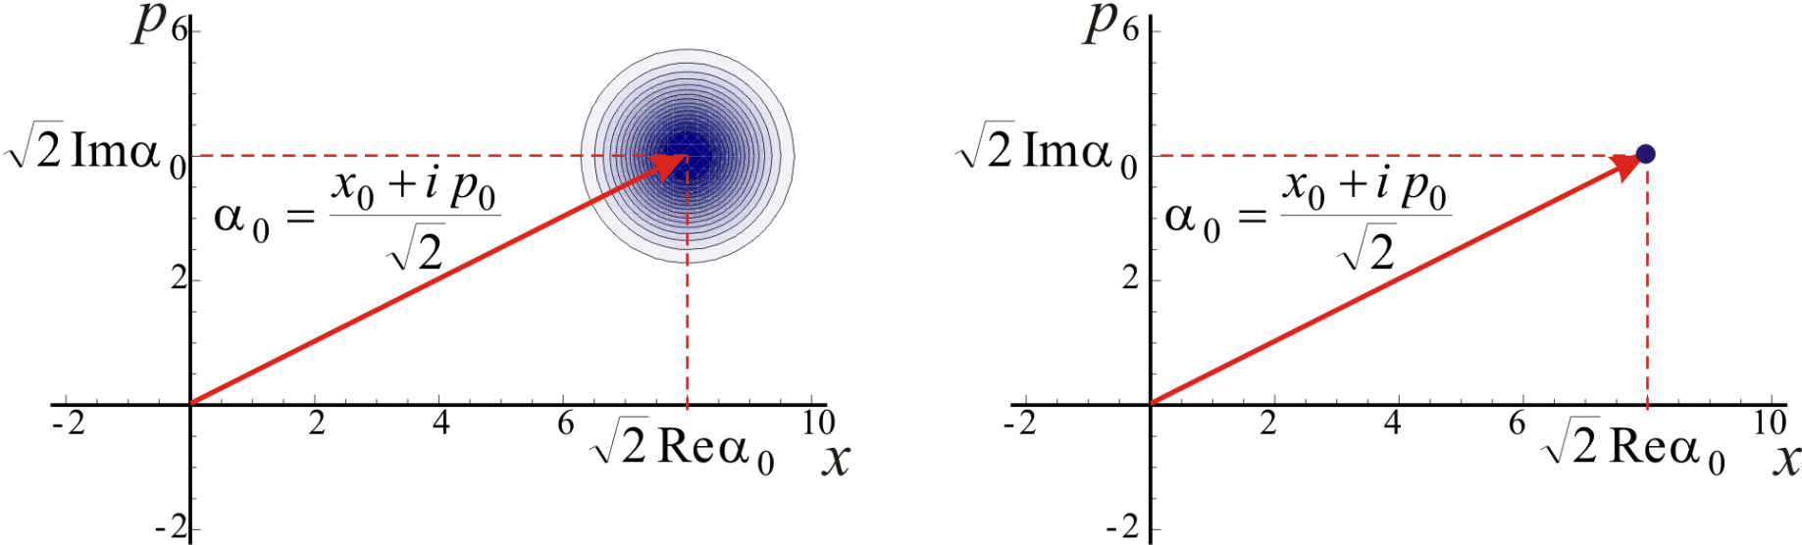
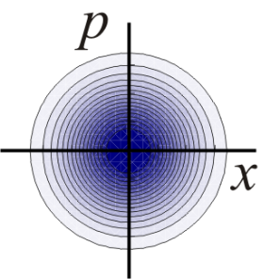
The P-function
[Glauber,1963; Sudarshan, 1963]
What is it?
  Deconvolution of the state’s Wigner function with the Wigner function of the vacuum state
Example
=
*
Wigner function of a coherent state
P-function of a coherent state

Slide 11
The P-function
[Glauber,1963; Sudarshan, 1963]
What about nonclassical states?
  Their Wigner functions typically have finer features than W₀(α)
  The P-function exists only in the generalized sense
The solution [Klauder, 1966]
  Any state can be infinitely well approximated by a state with a “nice” P function by means of low pass filtering

Slide 12
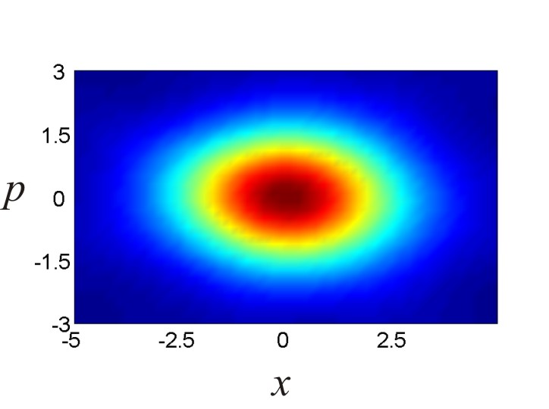
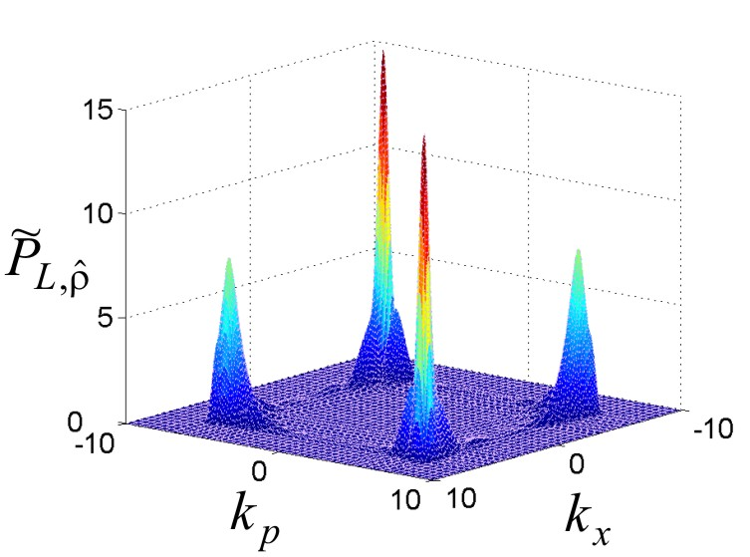
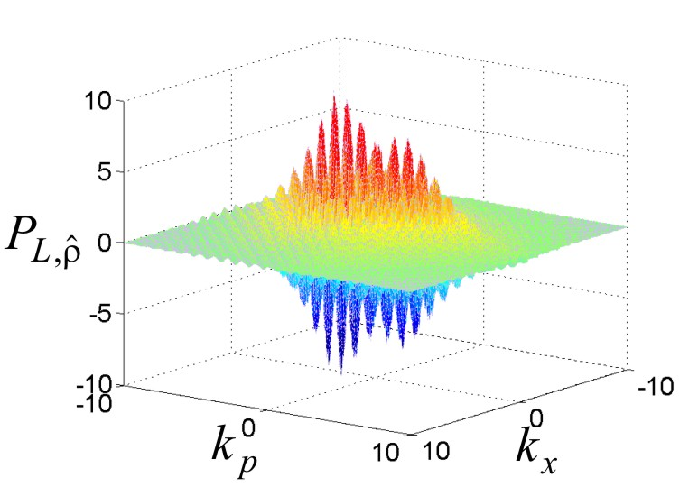

Example: squeezed vacuum
Wigner function
from experimental data
Bounded Fourier transform
of the P-function
Regularized P-function
Wigner function
from approximated P-function

Slide 13
Practical issues
  Need to choose the cut-off point L in the Fourier domain
  Can’t test the process for infinitely strong coherent states
  ⇒ must choose some α_{max}
  There is a continuum of α’s
  ⇒ process cannot be tested for every coherent state
  ⇒ must interpolate
  Process not guaranteed to be physical (positive, trace preserving)
  Many processes are phase-invariant
  ⇒ it is sufficient to perform measurements only for α’s on the real axis

Slide 14
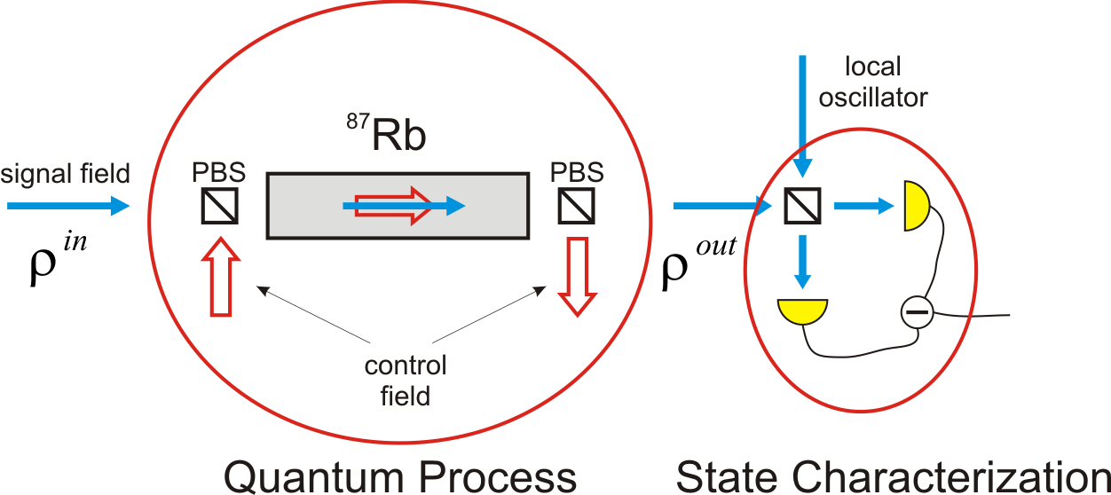
Example of application:
Memory for light as a quantum process
M. Lobino, C. Kupchak, E. Figueroa and A. L., PRL 102, 203601 (2009)

Slide 15
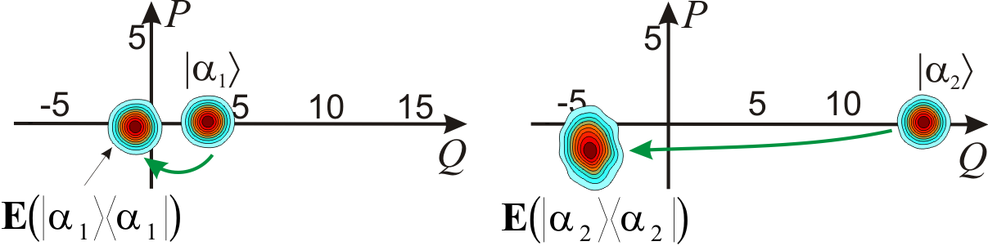
Process reconstruction
The experiment
  Input: coherent states up to α_{max}=10; 8 different amplitudes
  Output quantum state reconstruction by maximum likelihood
  Process assumed phase invariant
  Interpolation
How memory affects the state
  Absorption
  Phase shift (because of two-photon detuning)
  Amplitude noise
  Phase noise (laser phase lock?)

Slide 16
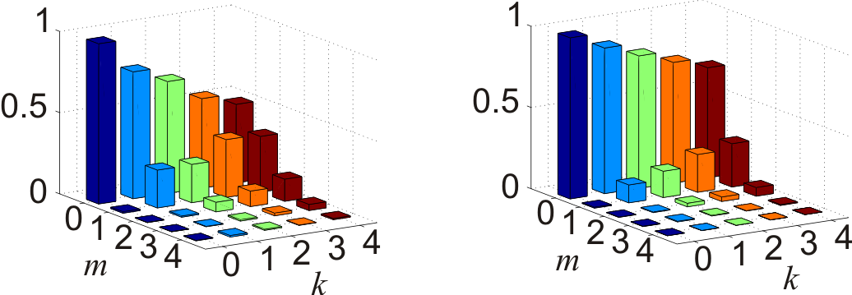
Process reconstruction: the result for photon number states
  Each color: diagonal elements of the output density matrix for a given input photon number state
output photons
output photons
input photons
input photons
Zero 2-photon detuning
540 kHz 2-photon detuning
We can tell what happens to the Fock states
without having to prepare them
Let us now verify by storing nonclassical states

Slide 17
Experiments on storing nonclassical light
Existing work
  L. Hau, 1999: slow light
  M. Fleischauer, M. Lukin, 2000: original theoretical idea for light storage
  M. Lukin, D. Wadsworth et al., 2001: storage and retrieval of a classical state
  A. Kuzmich et al., M. Lukin et al., 2005: storage and retrieval of single photons
  J. Kimble et al., 2007: storage and retrieval of entanglement
  M. Kozuma et al., A. Lvovsky et al., 2008: memory for squeezed vacuum
  = Various states of light stored, retrieved, and measured
Shortcomings
  Complicated
  Do not answer how an arbitrary state of light is preserved in a quantum storage apparatus.
Coherent-state process tomography resolves both shortcomings!

Slide 18
Method 2
Integration by parts

Slide 19
Finding the process tensor
Fock operators |n⟩⟨m|
  Process output:
  P function:
  Use integration by parts:
How to process experimental data
  Measure density matrix of for a set of α’s using homodyne tomography
  Fit every element of with a polynomial
  Elements of the process tensor are just coefficients of this polynomial!
Advantages of this method
  Elimination of integration and the ugly P function
  Elimination of a potential source of error (lowpass filtering)
  Dramatic simplification of calculations
experimental data
S. Rahimi-Keshari et al., New Journal of Physics 13, 013006 (2011)

Slide 20
Practical issue
  With experimental uncertainties, polynomial fitting is difficult.
  Fitting error increases with degree

Slide 21
Example: Creation and annihilation operators
Two fundamental operators of quantum optics
Non-unitary, non-trace preserving
Can be approximated in experiment

Slide 22
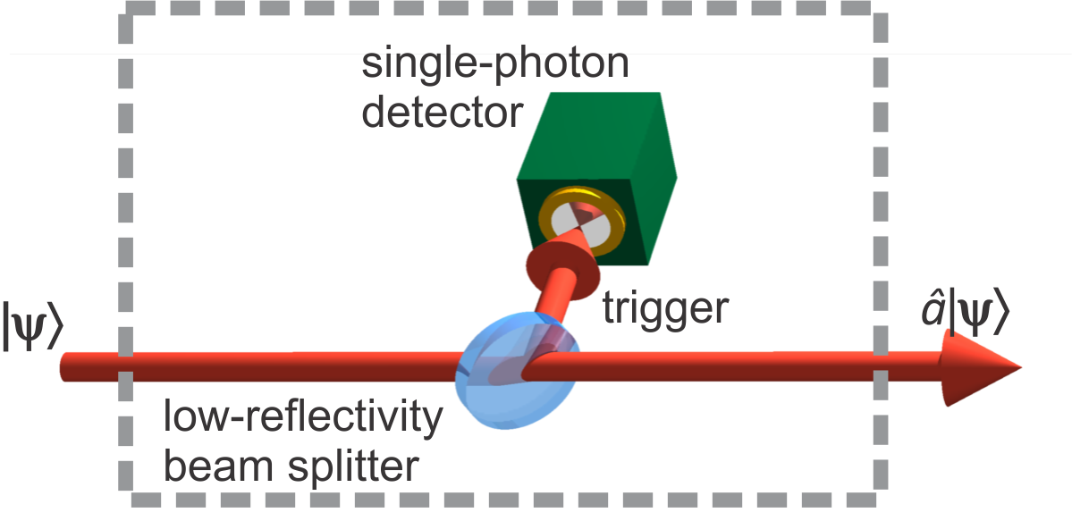
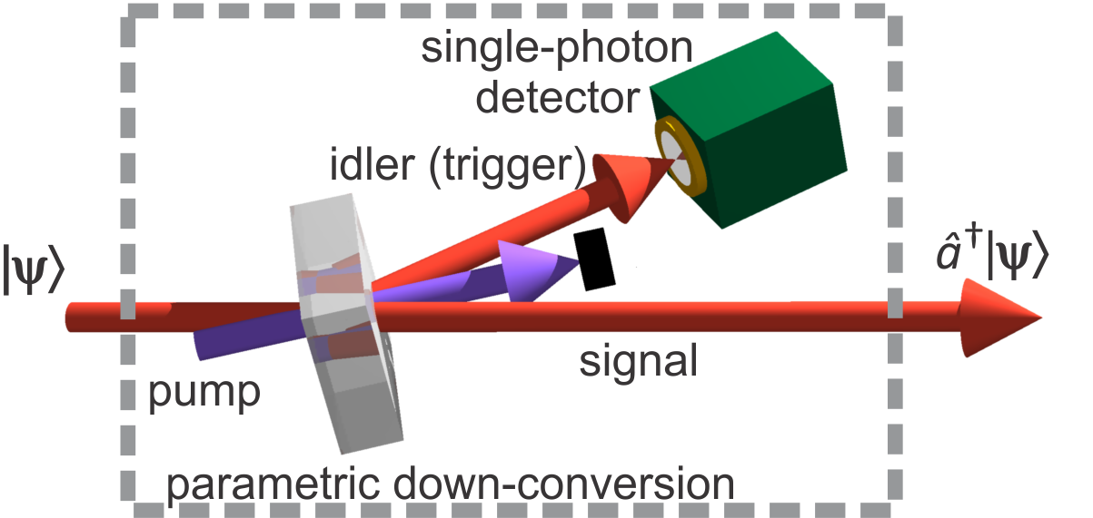
Photon creation and annihilation.
Experimental setup
Annihilation
  A “click” indicates that a photon has been removed from |ψ⟩
Creation
  A “click” indicates that a down-conversion event has occurred and a photon added to |ψ⟩
Accounting for non-unitary trace
  Trace of the process output is given by the “click” probability
  It must be included in the reconstruction formula

Slide 23
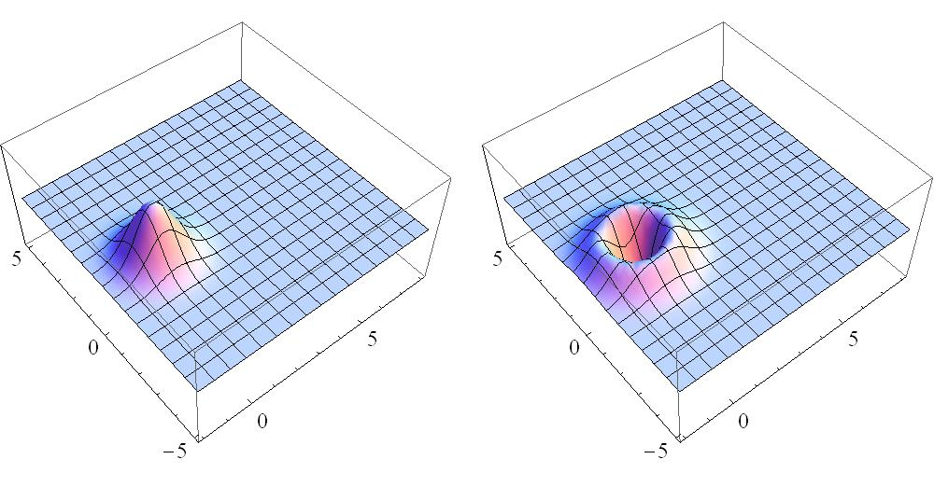
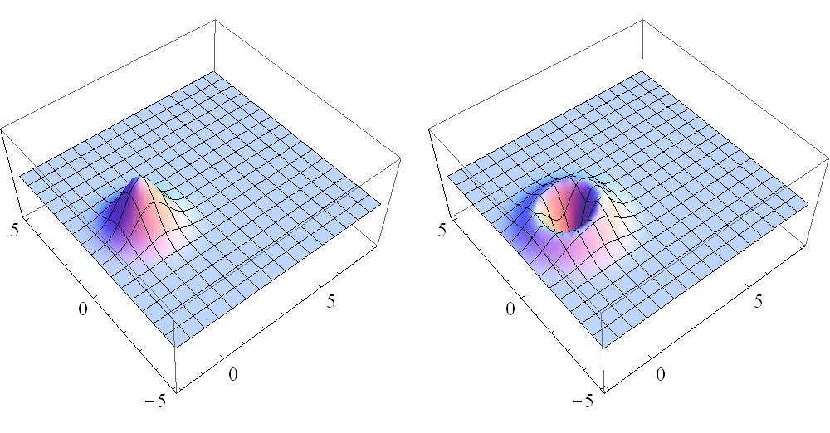
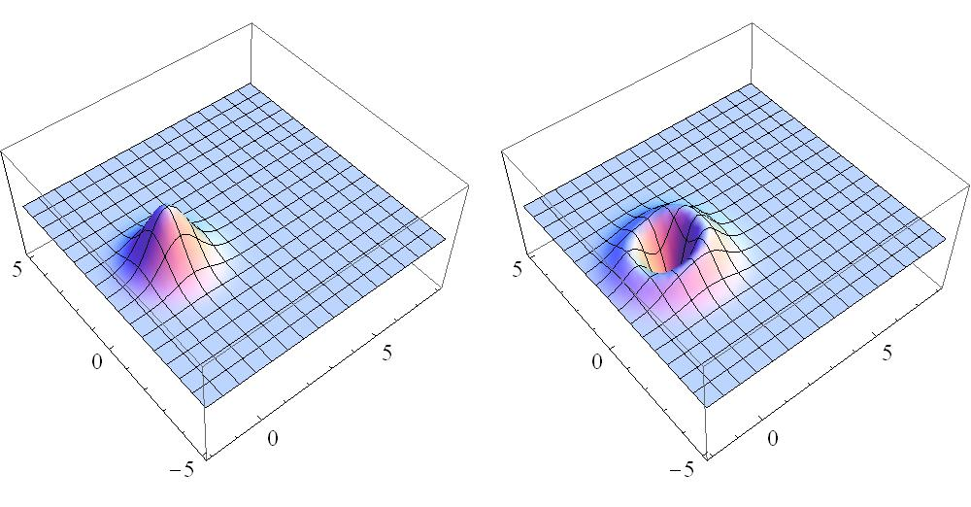
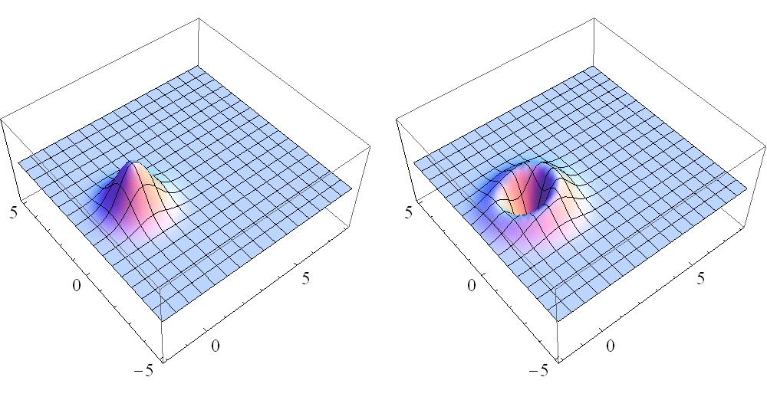
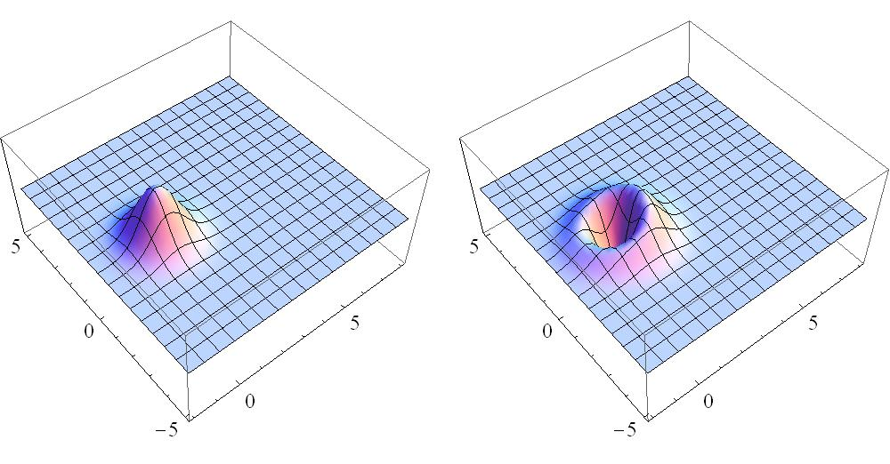



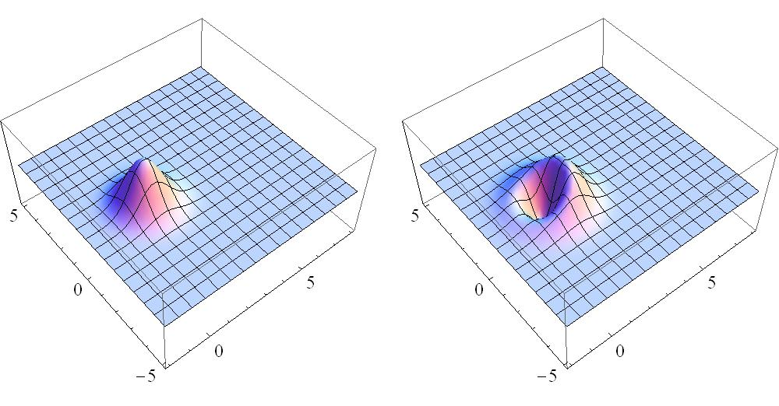


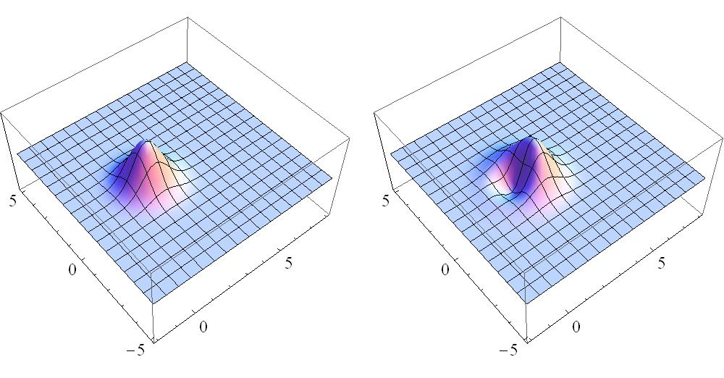
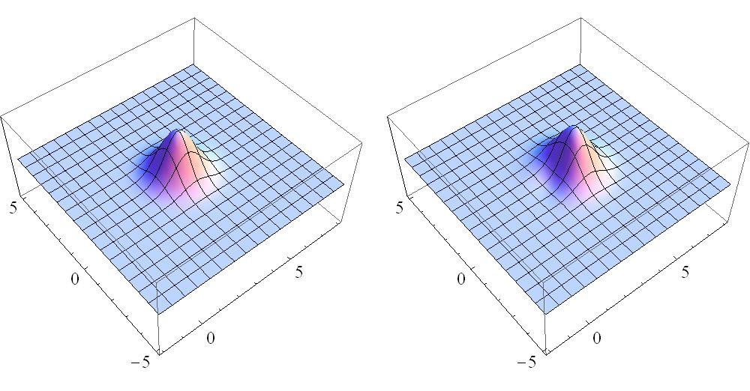
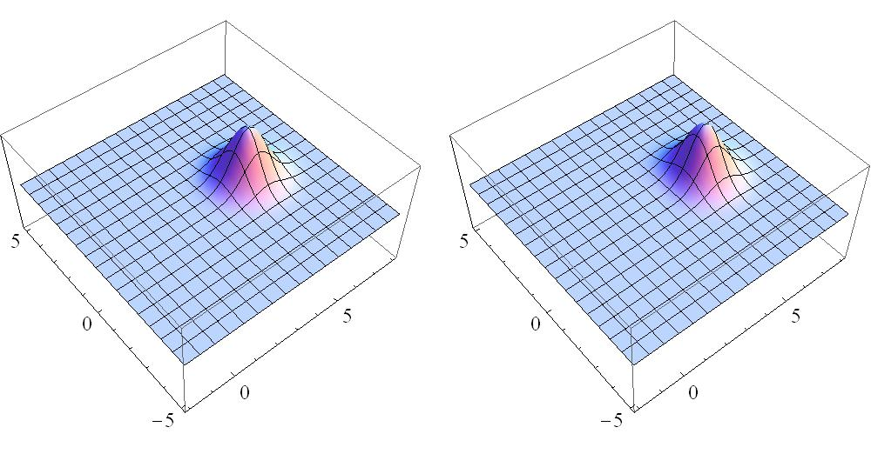
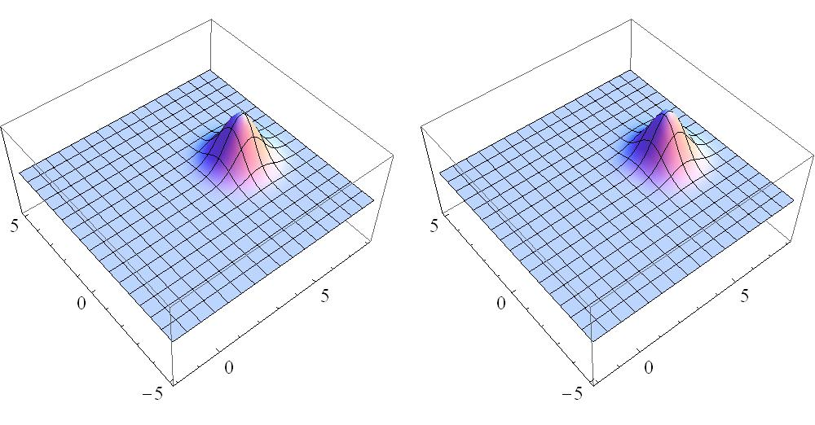
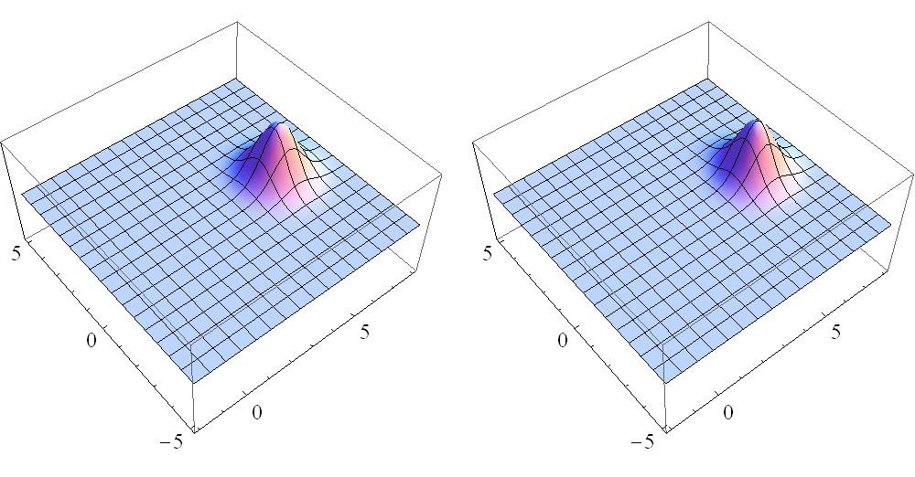
Photon creation operator acting on a coherent state [see also A. Zavatta et al., Science 306, 660 (2004)]
Initial coherent state
Photon-added coherent state
α increases
Behavior
  α → 0: Fock state (highly nonclassical)
  α → ∞: coherent state (highly classical)

Slide 24
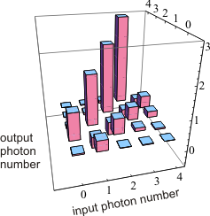
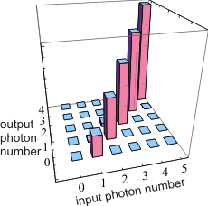
Photon creation and annihilation.
Process reconstruction
Annihilation
Creation

Slide 25
Method 3
Maximum-likelihood iterations

Slide 26
Fully statistical reconstriction
[Most ideas from: Z. Hradil et al, in Quantum State Estimation (Springer, 2004)]
Previous methods
  “Extremely tedious” (P. K. Lam)
  Physicality of process
    trace preservation,
    positivity
  not guaranteed
  would be nice to develop a fully statistical (MaxLik) reconstruction method
Jamiolkowski isomorphism
  Replace the superoperator process by a state in extended Hilbert space
original Hilbert space (H)
extension of Hilbert space (K)
  Then, for any probe coherent state input

Slide 27
Fully statistical reconstriction
(…continued)
Homodyne measurement on output state
  Projective measurement with operator
quadrature
phase
  Probabilty to obtain a specific quadrature value X is
treat this as a new “projector”
“unknown state”
“projective measurement”
  Can apply iterative MaxLik state reconstruction procedure!
A. Anis and AL,
New Journal of Physics 14, 105021 (2012)
Lagrange multiplier matrix to preserve trace

Slide 28
Handling non-trace-preserving processes
E.g. photon creation and annihilation
  Heralded process. Success probability g_{α} depends on the input state
Idea: introduce a fictitious state |Ø⟩
  No heralding event = projection onto |Ø⟩
  Modify L and R matrices accordingly

Slide 29
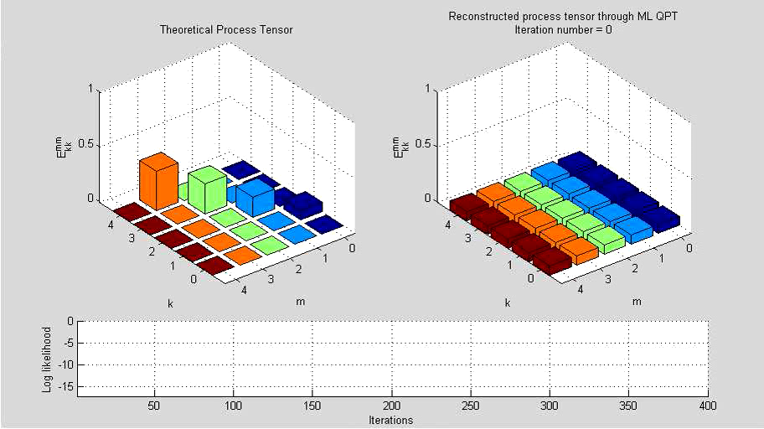
Photon creation
Process reconstruction video

Slide 30
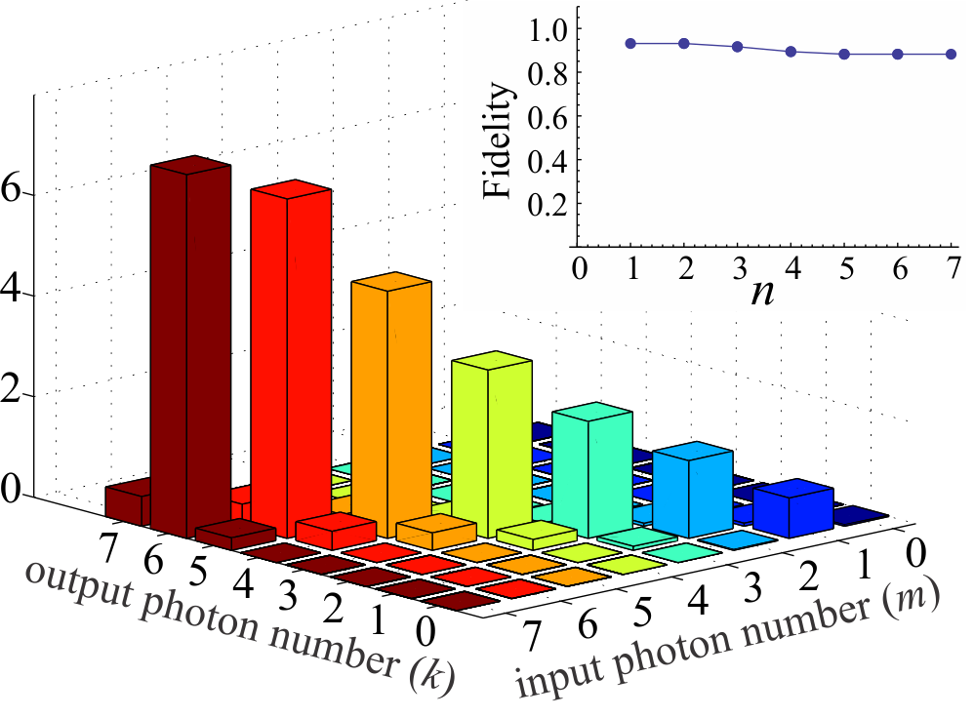
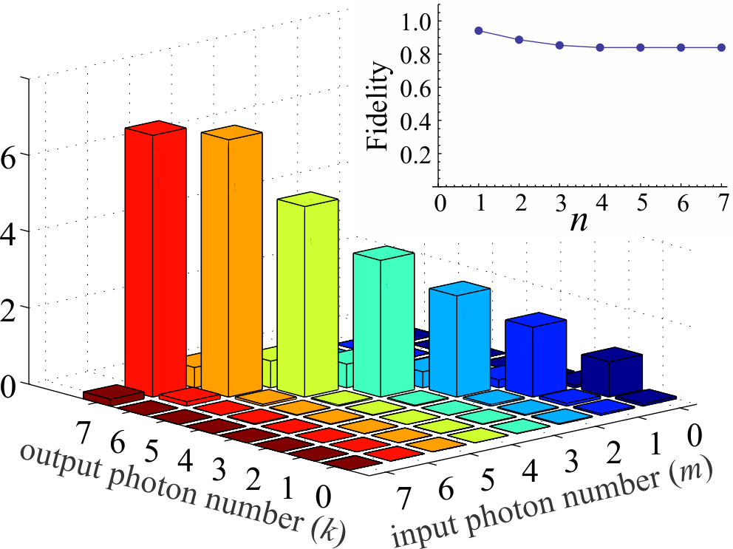
Photon creation and annihilation.
Process reconstruction
Annihilation
Creation
All probe coherent states’ amplitudes ≤ 1!
R. Kumar, E. Barrios, C. Kupchak, AL
PRL (in press)

Slide 31
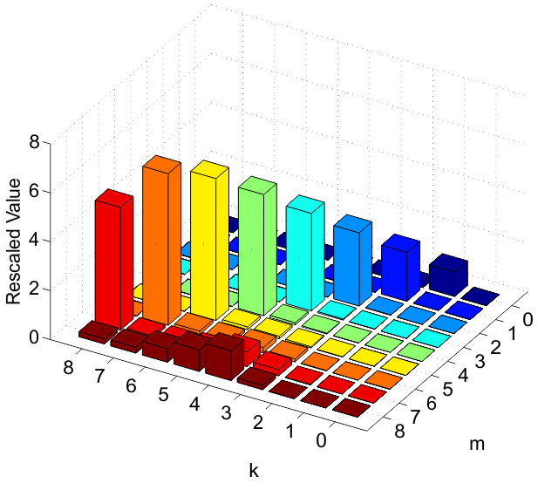
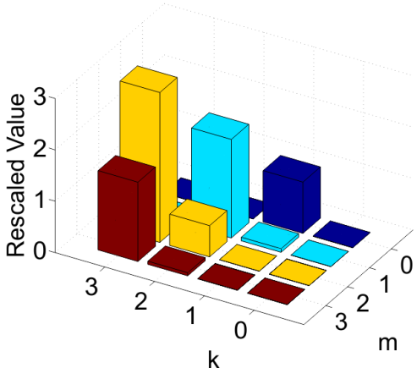
Issue: n_{max} vs. α_{max}
Photon creation
n_{max} = 8, α_{max} = 0.6
E.g. our experiment: n_{max} = 7.
Which α_{max} to choose?
  Too low: insufficient information
  about high photon number terms
  → errors in high number terms
  of process tensor
  Too high: input coherent states do not fit within the reconstruction space
  → trace ≠ 1
  → unpredictable errors in process tensor
Apparent solution
  First reconstruct with higher n_{max}.
  Then eliminate high number terms
  Works with simulated data, not so well in real experiment
Photon creation
n_{max} = 3, α_{max} = 0.6
A. Anis and AL, New Journal of Physics 14, 105021 (2012)

Slide 32
Coherent-state QPT
Summary
  By studying what a quantum “black box” does to laser light, we can figure what it will do to any other state
  Complete tomography
  Elimination of postselection
  Easy to implement and process (3 different ways)
  Tested in several experiments

Slide 33
The three methods
Summary
Method 1: approximating the P function
  Straightforward
  Tedious
  Requires high α_{max}
  Physicality of reconstructed process not guaranteed
Method 2: integration by parts
  Eliminates integration and the ugly P function
  Eliminates a potential source of error (lowpass filtering)
  Dramatic simplification of calculations
  Polynomial fitting can be finicky
Method 3: maximum-likelihood reconstruction
  Guarantees physicality
  Requires low α_{max}
  Computationally intensive
  Unresolved issues with reconstruction algorithm

Slide 34
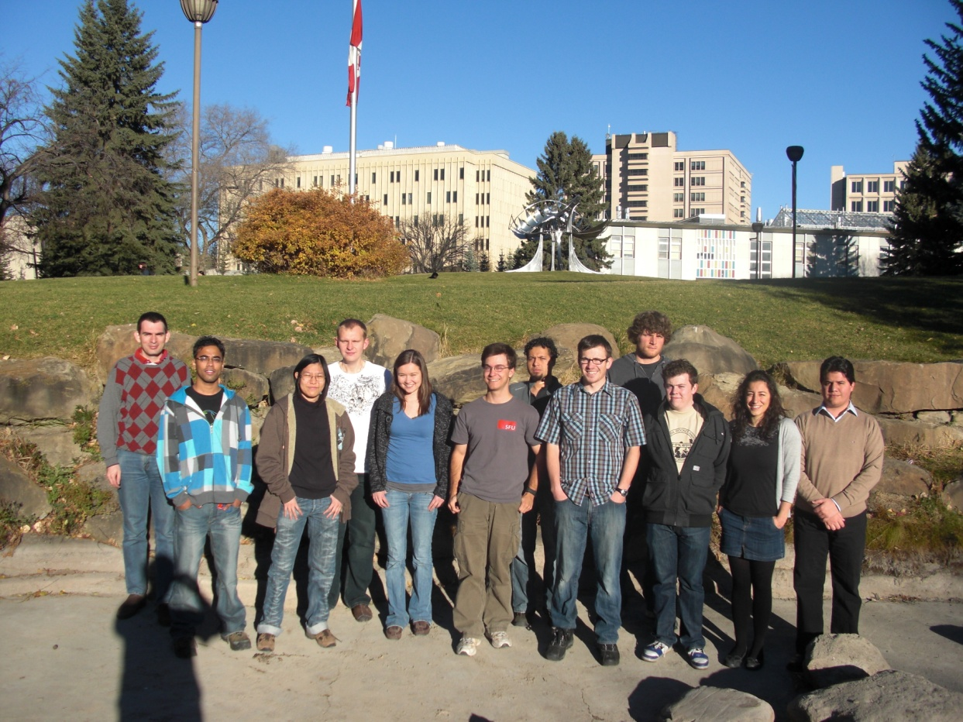





Thanks!
PhD student positions available
http://iqst.ca/quantech/

